Slide 1
INSULIN BY SYRINGE AND VIAL
Diabetes Care Tasks at School
What Key Personnel Need To Know
Notes:
The American Diabetes Association’s (“ADA”) Diabetes Care Tasks at School: What Key Personnel Need to Know is a training curriculum consisting of PowerPoint modules, some with corresponding video segments, pre-/post-tests and other helpful resources.
This curriculum is based on and should be used in conjunction with the ADA’s Safe at School Guide “Helping the Student with Diabetes Succeed: A Guide for School Personnel”. Training participants should read the ADA Safe at School Guide in conjunction with this training to gain a better understanding of the requirements for appropriate school diabetes care. The ADA’s Safe at School Guide can be found www.diabetes.org/sastraining.
Some key points about the overall training:
Overall objective: The overall goal is to optimize safety, health, learning, and access for students with diabetes by providing diabetes education and training to school personnel to perform routine and emergency diabetes care tasks for students, under the supervision of a school nurse or another qualified health care professional. Completion of this training will help prepare school personnel to perform diabetes care tasks, ensuring that health needs are addressed in times and locations when a nurse is not available to provide needed care.
Rationale: The school nurse, when available, is the most appropriate person in the school setting to provide care for a student with diabetes. However, many schools do not have full-time nurses. Even for schools that do, the nurse may not always be available at all times during the school day, during school-sponsored extra-curricular activities or field trips to assist with routine care and emergency care. Trained school personnel must be available to perform and assist the student with diabetes care tasks.
PLEASE STATE: This presentation is not intended to provide legal or health care advice. Please consult with a legal or health care professional regarding your specific questions or needs.

Slide 2
Optimal Student Health and Learning
GOAL:
Accurate and timely insulin dosing is a vital piece of the Diabetes Medical Management Plan (DMMP).
Notes:
Each training component was created specifically for school nurses and other qualified health care professionals to train school personnel.
These components are:
• Diabetes Basics
• Diabetes Medical Management Plan
• Hypoglycemia
• Hyperglycemia
• Blood Glucose Monitoring
• Continuous Glucose Monitoring
• Glucagon Administration
• Insulin Basics
• Insulin by Syringe and Vial
• Insulin by Pen
• Insulin by Pump
• Ketones
• Nutrition and Physical Activity
• After-School Programs, Sports and Camps
• Before- and After- School Care
• Childcare
• Psychosocial Aspects
• Legal Considerations
• Type 2 Diabetes
This unit is Insulin by Syringe and Vial.

Slide 3
Learning Objectives
PARTICIPANTS WILL BE
ABLE TO UNDERSTAND:
Types of syringes
Where on the body to inject insulin
Preparation steps for syringe injection
How to dose with a syringe
How to inject with a syringe
Notes:
Participants will be able to understand:
Types of syringes
Where on the body to inject insulin
Preparation steps for syringe injection
Participants will be able to demonstrate:
How to dose with a syringe
How to inject with a syringe
In addition to understanding insulin dosing and delivery using a vial and syringe, it is important that those administering insulin to a student or assisting a student with insulin administration understand the fundamentals of insulin action, dosing and delivery. These general concepts are covered in the unit entitled “Insulin Basics.”

Slide 4
Method of Delivery
Syringe and vial may be used for those on injections but also for those on insulin pump therapy during times of pump malfunction
INSULIN INJECTION
INSULIN PUMP
Prescribed insulin therapy
Follow DMMP
Prescribed for insulin pump malfunction
Follow DMMP
Notes:
Method of insulin delivery is determined by the student, parent/guardian and provider and therapy may change. Some students may only ever use insulin injections while others may transition to insulin pump therapy, which will be discussed in another separate unit on insulin pumps. It’s important to be prepared that students on insulin pumps may still require injections during cases of pump or pump site malfunction. Some students on insulin pump therapy may also return to injections; see current DMMP for therapy.

Slide 5
Insulin Injections
Inject into fatty layer under skin
Rotate sites
Student should choose site unless there is lipohypertrophy (scar tissue)
Common insulin injection sites:
Abdomen, thighs, buttocks, upper arms
Notes:
Insulin works best when it is injected into a layer of fat under the skin, above the muscle tissue.
Rotating sites is important to insulin absorption.
Common preferred sites are the abdomen, thighs, buttocks, and upper arms.
Student should help choose injection site.

Slide 6
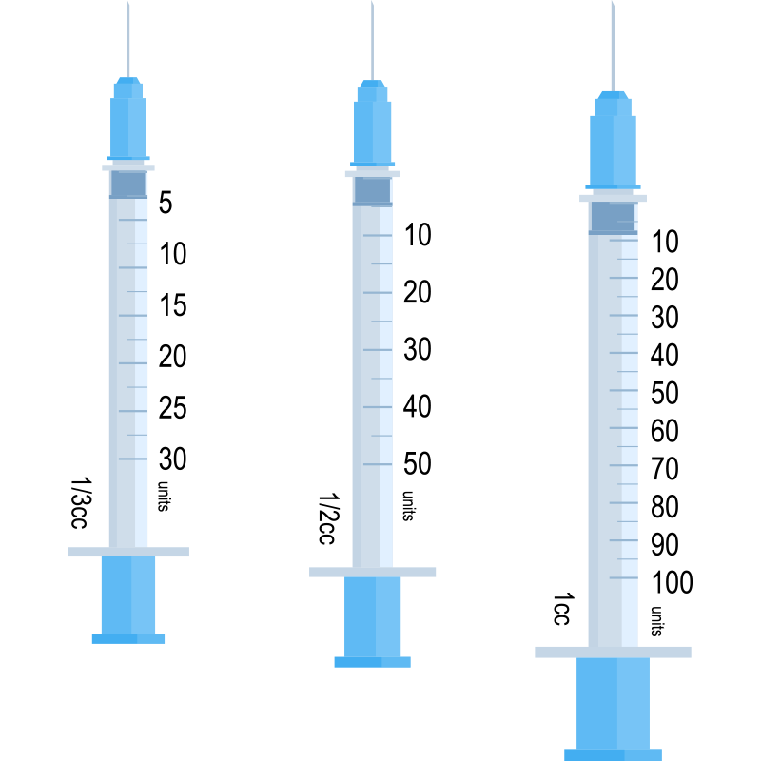
Insulin Syringes
SIZES—30, 50, 100 UNITS
Whole unit markings
Half unit markings
DISPOSAL
Do not reuse
Do not recap
Notes:
Insulin syringes
Different size syringes are available: 1/3 cc (30 units), ½ cc (50 units), and 1 cc (100 units).
Generally, each horizontal marking indicates 1 unit on 30 and 50 unit syringes, and 2 units on 100 unit syringes. However, some students may use 30 unit insulin syringes that have scales for both half and whole units.
Needles and syringes should be disposed of in a manner consistent with Universal Precautions and local waste disposal laws.

Slide 7
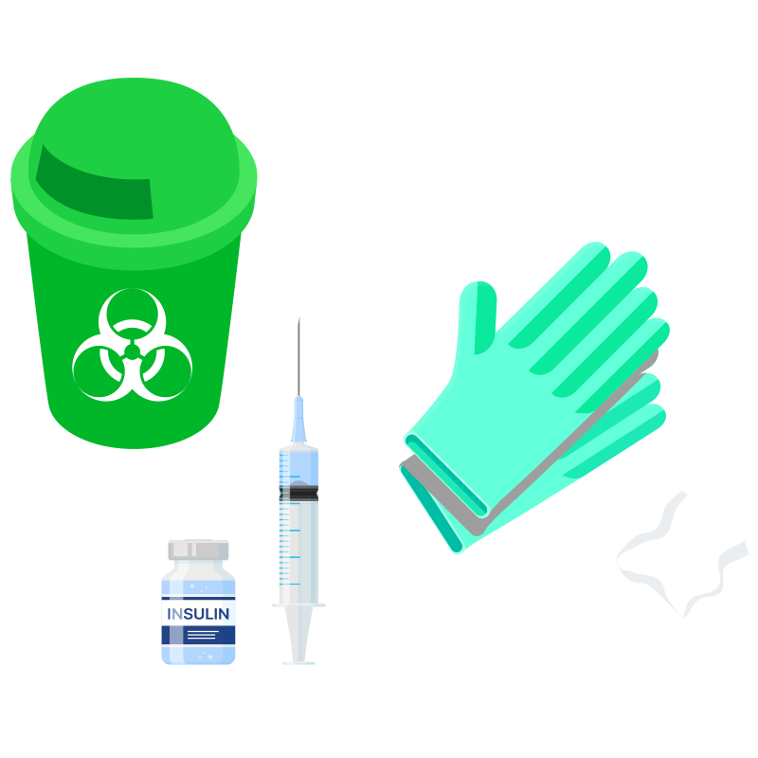
Syringe and Vial: Preparation
1. Gather supplies:
Insulin (Verify type of insulin)
Syringe
Alcohol wipe
Disposable gloves
Sharps container
Notes:
Method: Syringe and vial
Get supplies:
insulin
syringe and needle
alcohol wipe
gloves
sharps container
Be sure to verify the type of insulin before drawing up into the syringe.

Slide 8
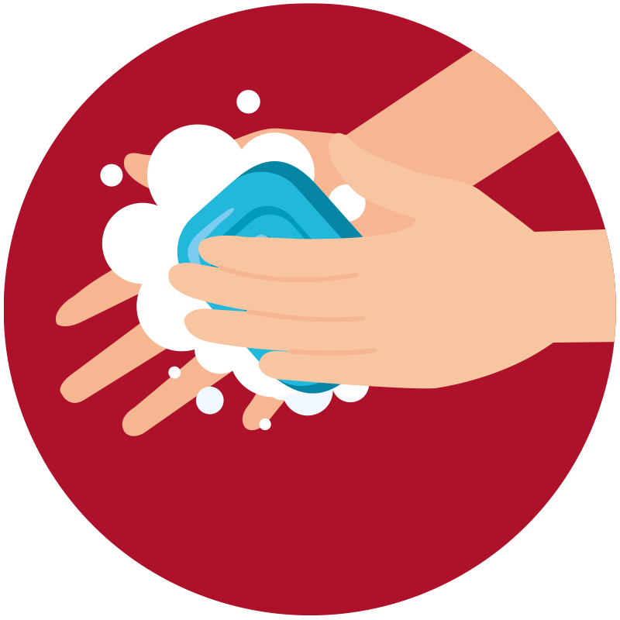

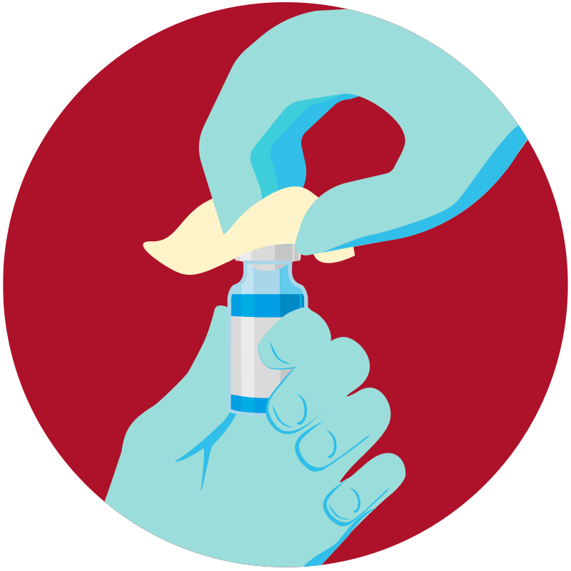
Syringe and Vial: Preparation
Wash hands and apply gloves
Clean the top of the insulin vial with alcohol swab
Notes:
Method: syringe and vial
2. Wash hands and apply gloves.
3. Clean the rubber top of the insulin vial with an alcohol swab.

Slide 9
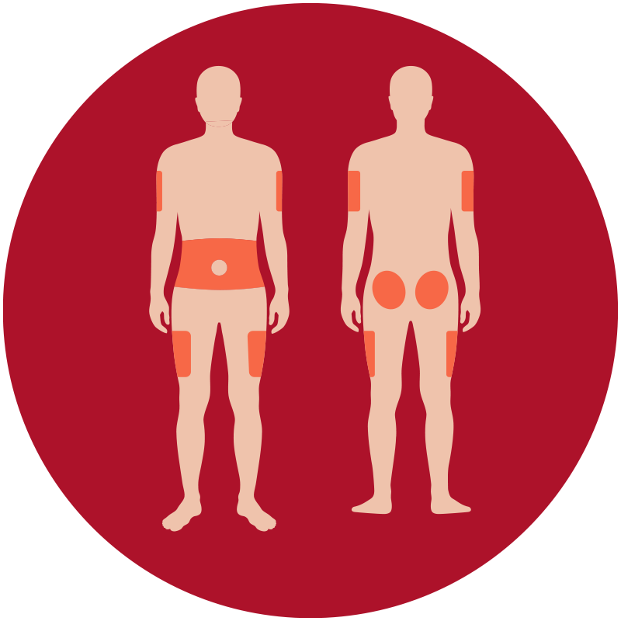
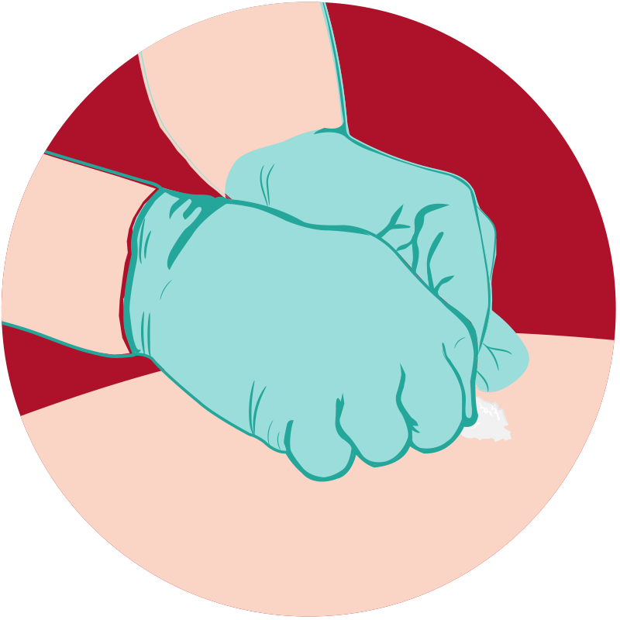
Syringe and Vial: Preparation
Have student select
injection site, avoiding lipohypertrophy
Clean the injection site and allow to air dry
Notes:
Method: syringe and vial
4. Have student select injection site per DMMP. Common sites are upper arm, thigh, stomach, and buttocks.
5. Clean the injection site and wait to dry.

Slide 10
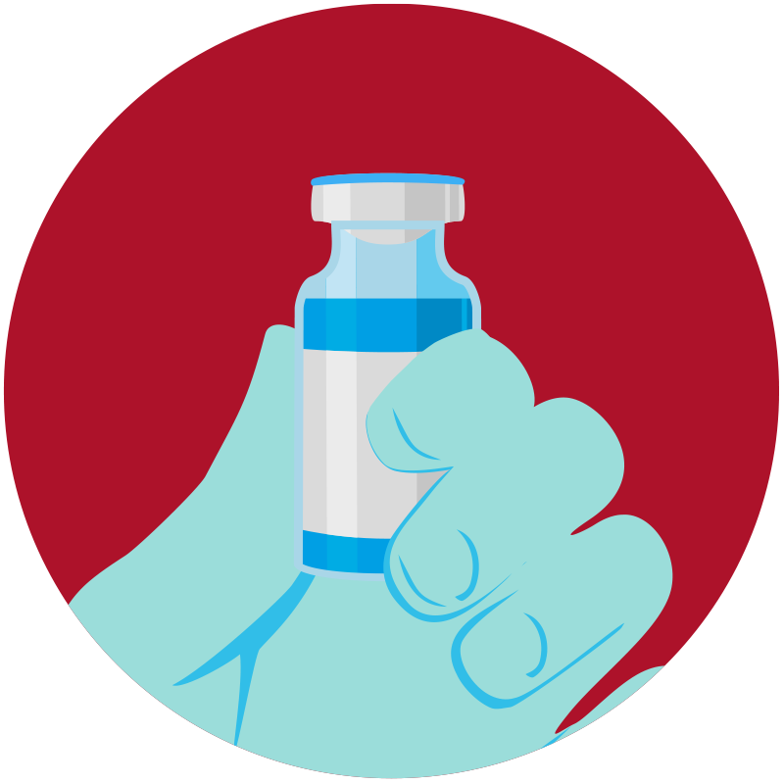
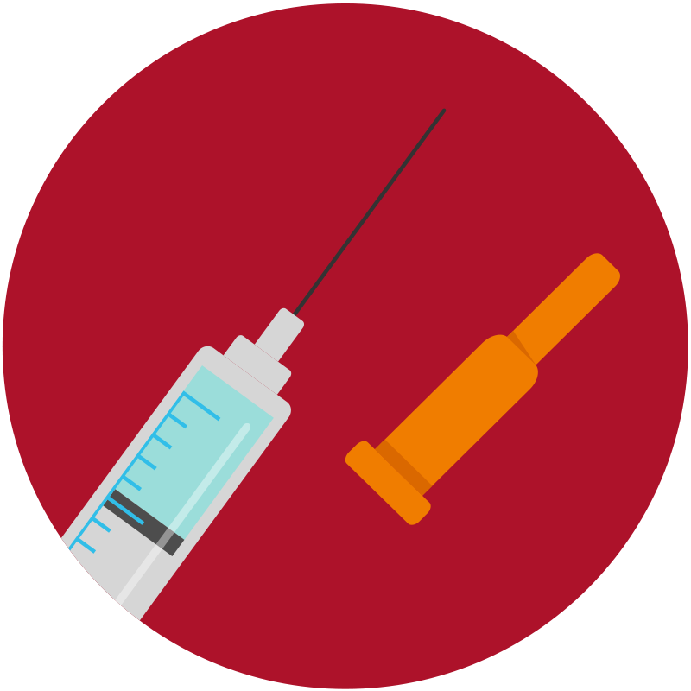
Syringe and Vial: Preparation
Check the insulin dose orders
Remove the cap from syringe
Notes:
Method: syringe and vial
6. Check the insulin dose. Verify each of the following:
student
insulin
where/how delivered
specific dose for conditions
7. Remove the cap from syringe. Do NOT touch the needle.

Slide 11
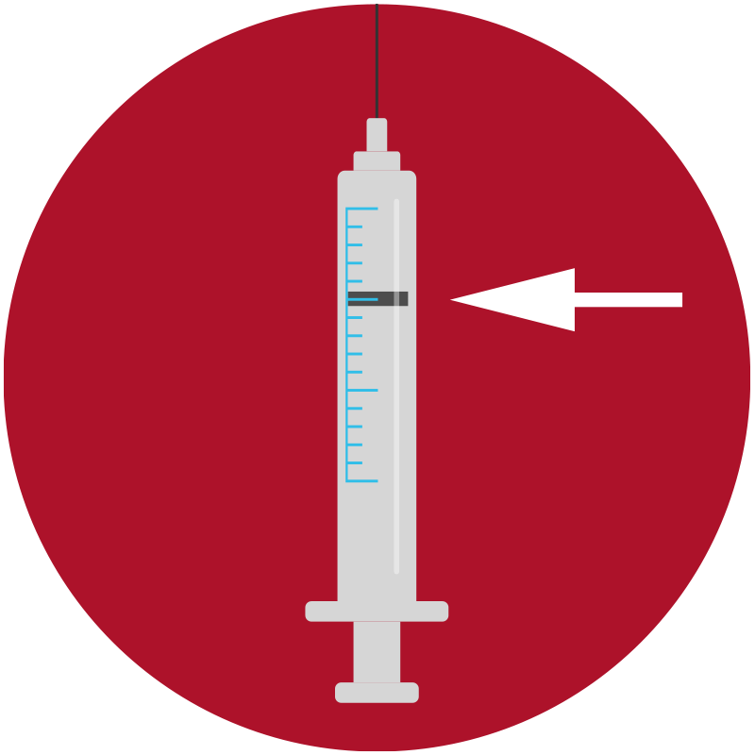
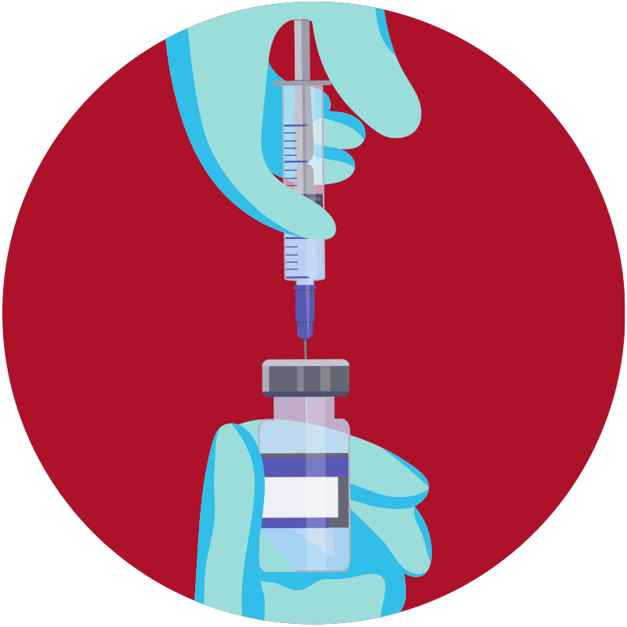
Syringe and Vial: Preparation
Pull the plunger down to number of units to be administered
Inject air into bottle
Notes:
Method: syringe and vial
8. Pull the plunger down to the number of units to be administered.
9. Push the needle into the bottle and push the plunger in with the syringe tip down. This will inject air into the bottle to prevent the development of a vacuum.

Slide 12
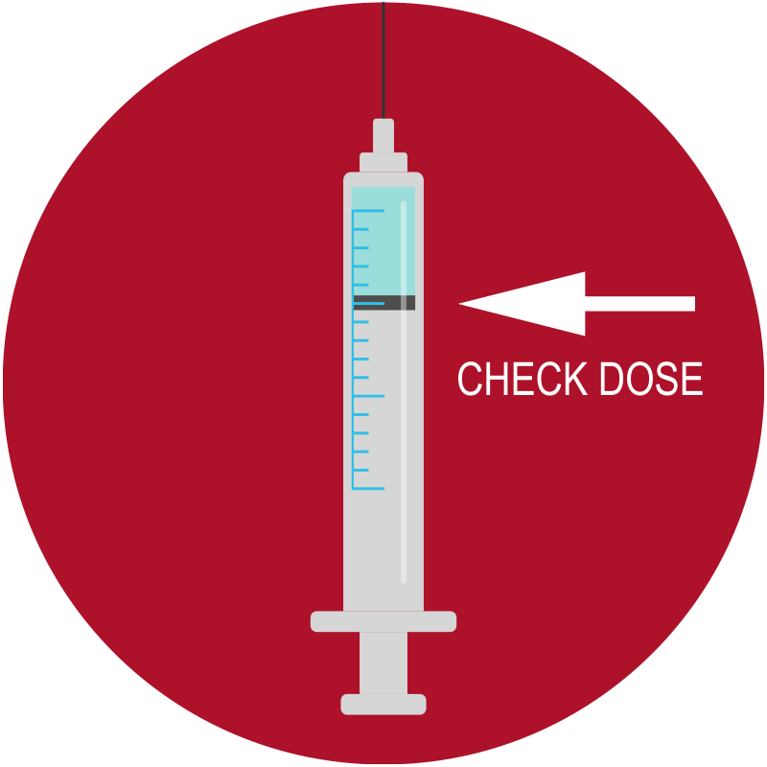
Syringe and Vial: Dosing
Draw out prescribed number of units of insulin as per DMMP
Please note insulin vials should never be shared amongst students
Notes:
Method: syringe and vial
10. With the needle still the in bottle, turn the bottle and syringe upside down and pull the plunger down to prescribed number of units of insulin as per DMMP. Check dose and type of insulin with DMMP specifications.

Slide 13
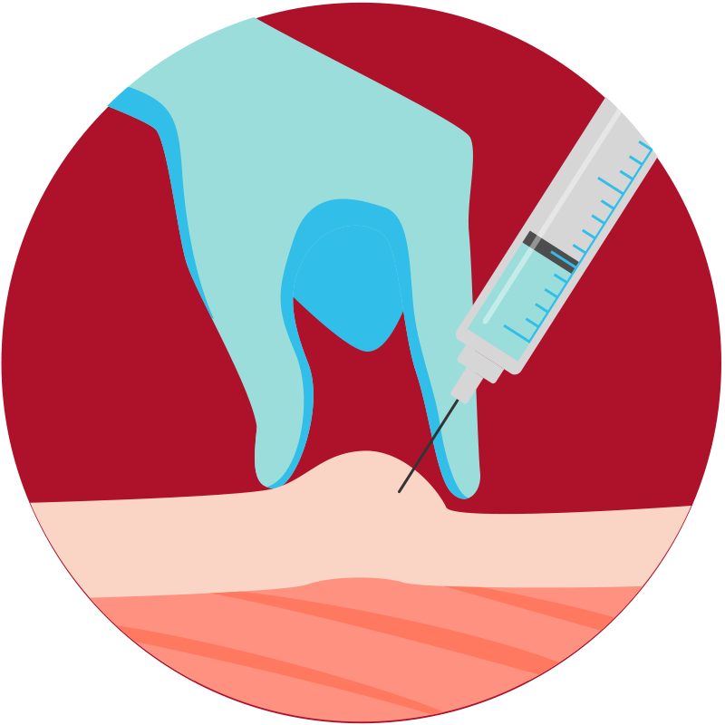
Syringe and Vial: Injecting
Pinch up the skin
Push needle into skin at 90°, 45° if necessary to avoid muscle
Release pinch
Push the plunger in
Count to 5 seconds
Remove needle and dispose of syringe; do not re-cap before discarding syringe
Document time, dosage, site, and blood glucose value
Notes:
Method: syringe and vial
11. Pinch up the skin to avoid injecting into muscle
12. Push the needle into the skin at 90. A 45° angled approach may be recommended for lean students to avoid intramuscular injection.
13. Release pinch
14. Push the plunger in
15. Count to “5”
16. Remove needle and dispose of syringe as per student’s DMMP and local ordinances. Never re-cap.
17. Document time, dosage, site, and blood glucose value

Slide 14
Module 11 Pre- and Post-Tests:
INSULIN BY SYRINGE AND VIAL
This tool may be freely duplicated and distributed for training purposes

Slide 15
Rotating injection sites is important.
  True
  False
Insulin syringes should be recapped.
  True
  False
Which site is not an injection site:
  Upper arm
  Stomach
  Calf
  Thigh
  Buttocks

Slide 16
Disclaimer
This presentation is not intended to provide legal or health care advice. Please consult with a legal or health care professional regarding your specific questions or needs.

Slide 17
Where to Get More Information
AMERICAN DIABETES ASSOCIATION
1-800-DIABETES (342-2383)
DIABETES.ORG/SAFEATSCHOOL

